Slide 1
Reac js Class component
https://www.youtube.com/watch?v=lnV34uLEzis&list=PLslBXCQgkwmWOXqtqbgdsjuLs4_zU1NEI&index=6

Slide 2
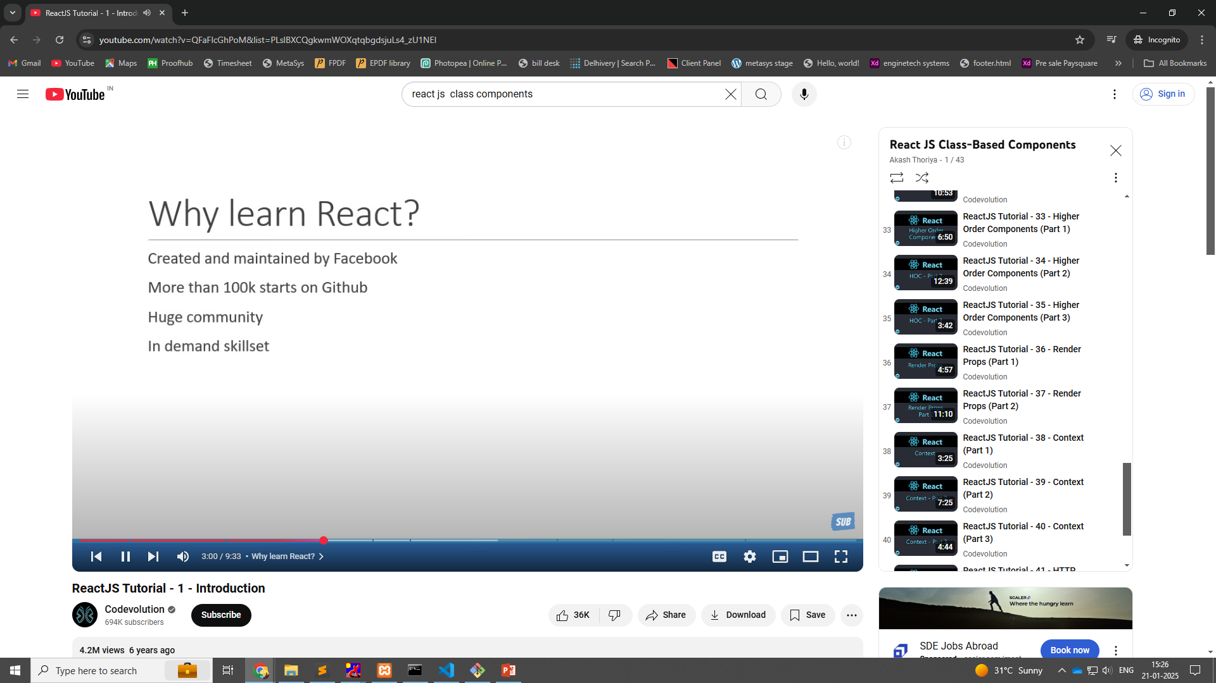
Introductions

Slide 3
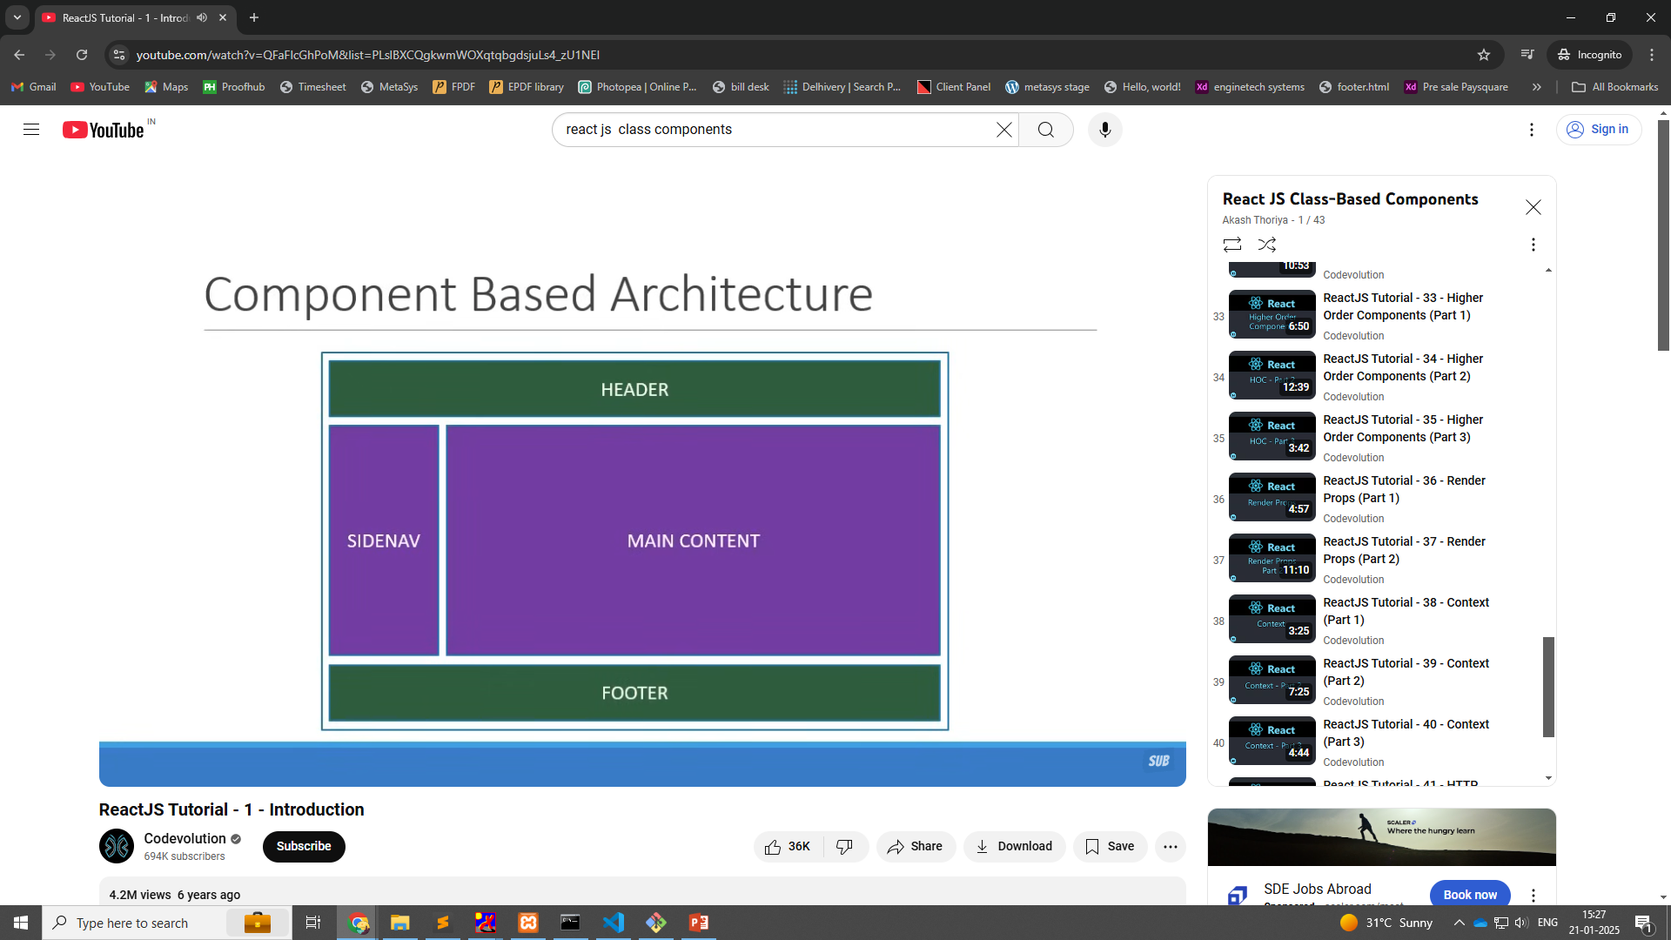
Component base architecture

Slide 4
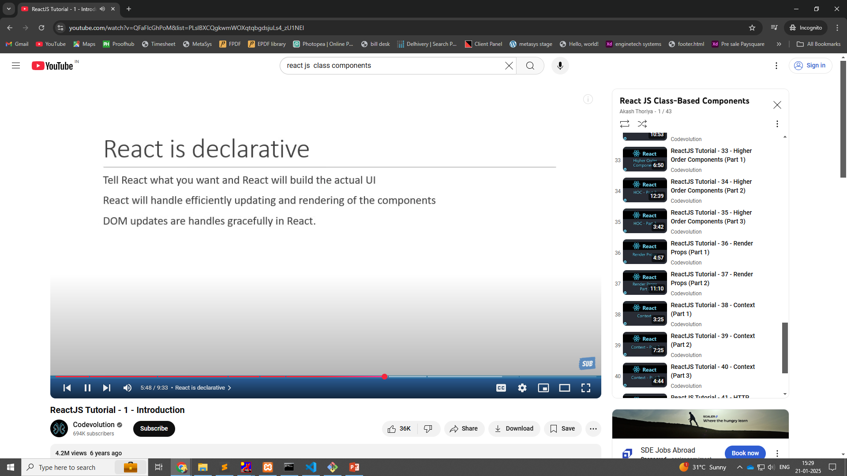

Slide 5
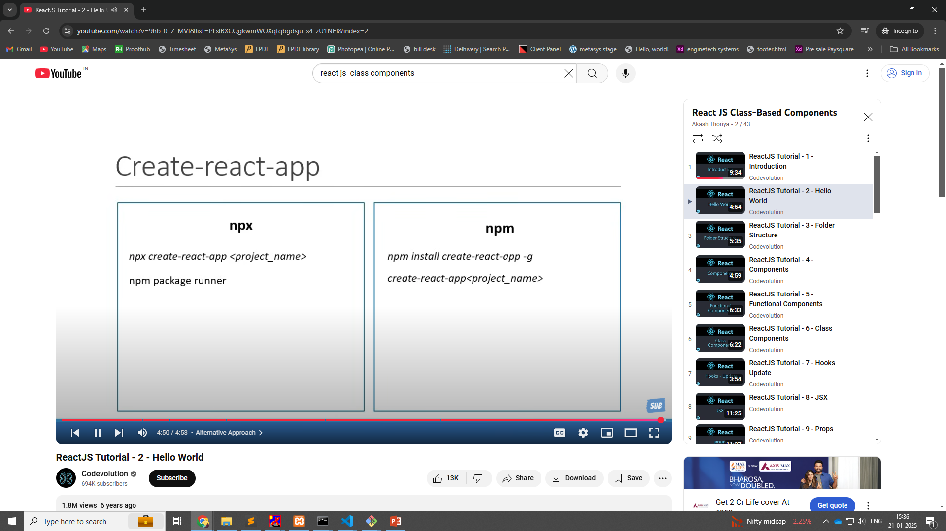

Slide 6
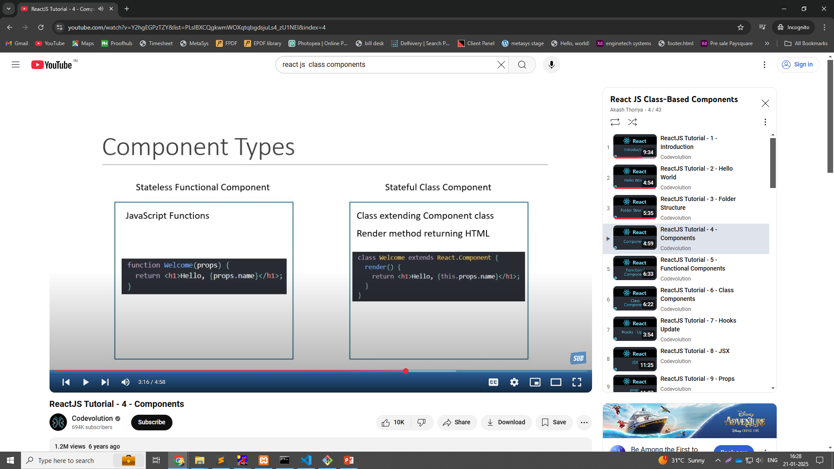
Class & Function componens

Slide 7
